Slide 1

Early Detection of Gestational Diabetes Mellitus
HDS-5330-01
Neha Sri Tella
Rathnakar Rajanala
Lakshmi Anusha Tiyyala
Sai kumar chary Sripathi
Roshini amulla

Slide 2
Table of contents
Data Description
Step 1 – Data Collection
Step 2 – Data visualization
Step 3 – Regression
Step 4 – KNN & Naïve bayes
Step 5 – SVM
Step 6 – Random forest
Conclusion
References
Contribution

Slide 3
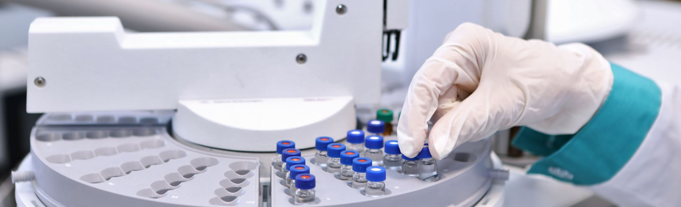
Objective:
To Develop a machine learning model to predict whether a pregnant women has diabetes based on various medical predictor variables. The goal is to create a model that can accurately identify patients at risk of diabetes, enabling early intervention and better management of the condition.

Slide 4

Step 1: Data Collection
Define the project.
Define data.
Collect data.

Slide 5
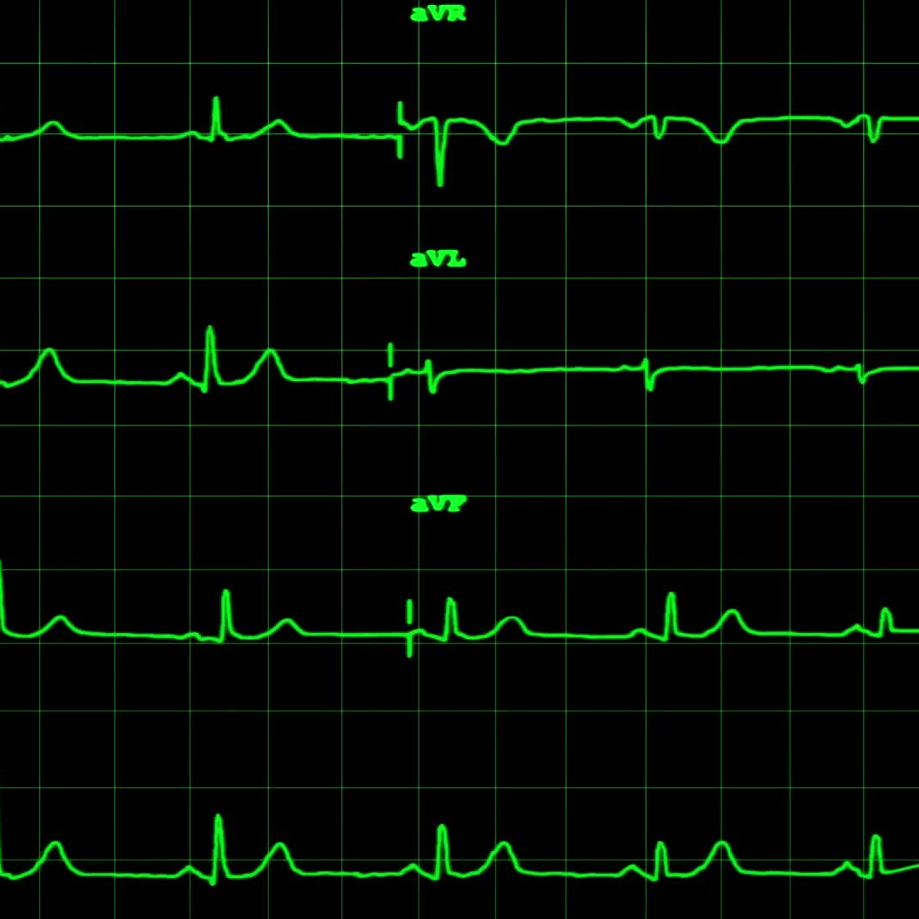
Data Description
Diabetes Prediction Dataset
Source: Kaggle (provided by user: mrsimple07)
Dataset link:- https://www.kaggle.com/datasets/mrsimple07/diabetes-prediction?resource=download
Description: This dataset is used for predicting whether a pregnant women has diabetes based on various health metrics.
Number of Records: 768
Features: Includes medical attributes such as glucose levels, blood pressure, skin thickness, insulin, BMI, age, and more.
Objective: The primary goal is to predict diabetes presence in patients using these medical attributes.

Slide 6
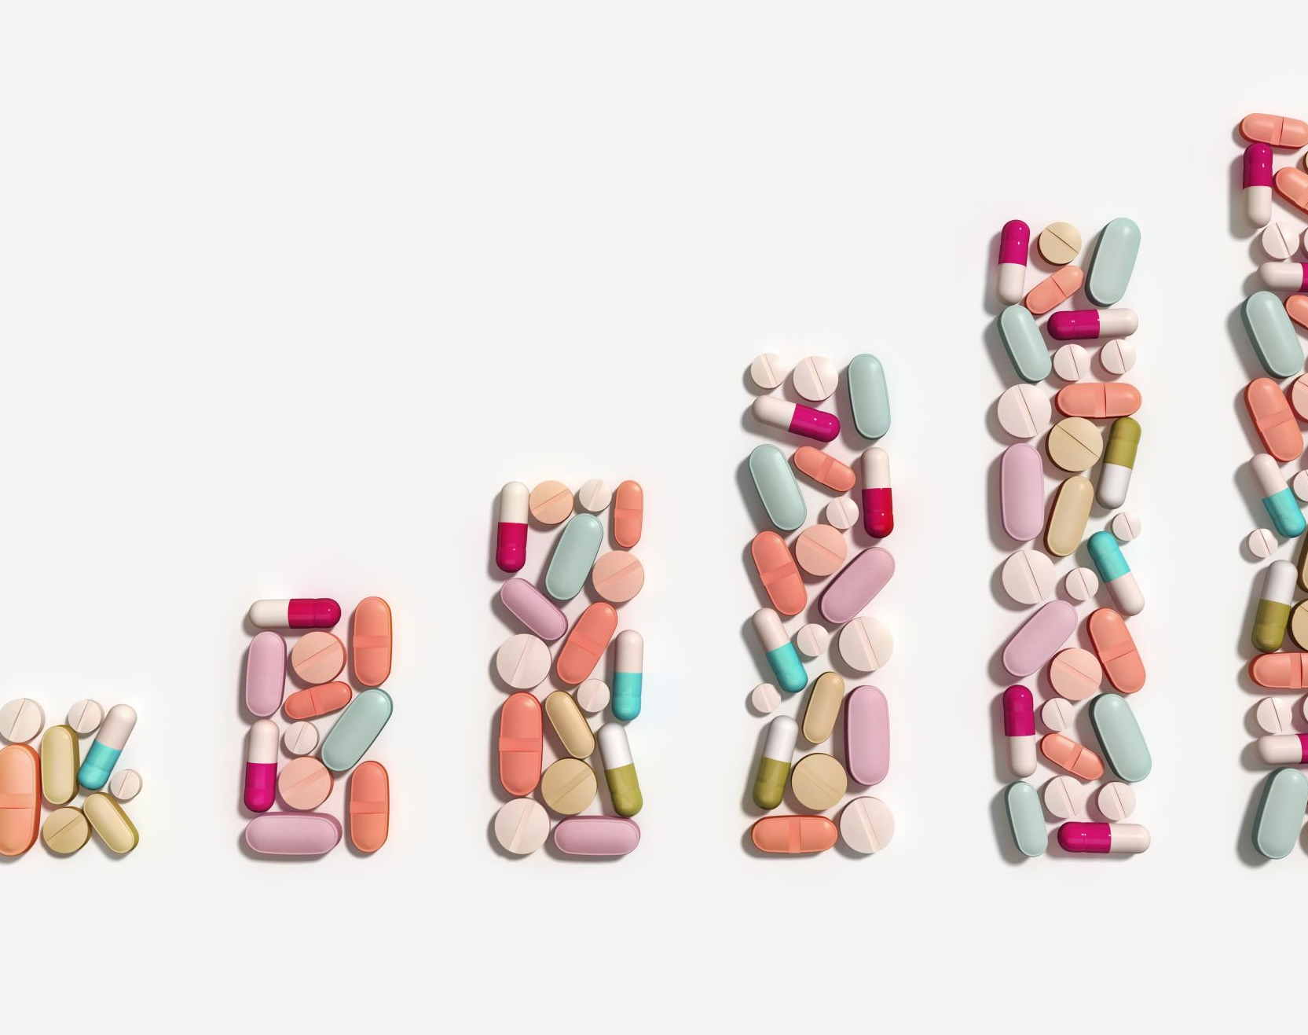
About Dataset
The dataset generated for diabetes prediction purposes contains a range of features associated with diabetes risk factors. These features may include variables such as blood sugar levels, body mass index (BMI), age, family history, and other relevant health indicators. Each set of feature values is accompanied by a diagnosis label that indicates whether the individual has diabetes or not. This dataset is valuable for training machine learning models to predict the likelihood of diabetes based on the provided risk factors. It can be used for research, analysis, and the development of predictive models aimed at improving diabetes diagnosis and management.

Slide 7

Data attributes – Name of Columns It has 7 Decimal value columns and 2 integer value columns.
Pregnancies: Number of times the patient has been pregnant.
Glucose: Plasma glucose concentration a 2 hours in an oral glucose tolerance test.
Blood Pressure: Diastolic blood pressure (mm Hg).
Skin Thickness: Triceps skinfold thickness (mm).
Insulin: 2-Hour serum insulin (mu U/ml).
BMI: Body mass index (weight in kg/(height in m)^2).
Diabetes Pedigree Function: A function that scores the likelihood of diabetes based on family history.
Age: Age of the patient in years.
Outcome: Binary variable (0 or 1) indicating whether the patient has diabetes.

Slide 8
Step 2. Data Visualisation
MAJOR DISCUSSION:
FEATURE SELECTION:-
The objective is to find appropriate characteristics for modeling and analysis. Making the appropriate feature selections enhances model performance and facilitates comprehension of the data's relationships.
Criteria: For visualizations such as box plots, histograms, and scatter plots, numerical features are frequently chosen. Examples are blood pressure, age, and glucose.
Bar or pie charts are commonly used to illustrate categorical characteristics, showing the distribution of categories. An illustration would be a diagnosis (diabetes or not).
Significance of the feature: To determine which aspects are more predictive for the issue, use correlation matrices or alternative methods (such as feature importance from models).

Slide 9

DATA VISUALISATION
Objective: To Investigate trends, patterns, and connections between features using visualizations. This helps in comprehending data before developing models.

Slide 10
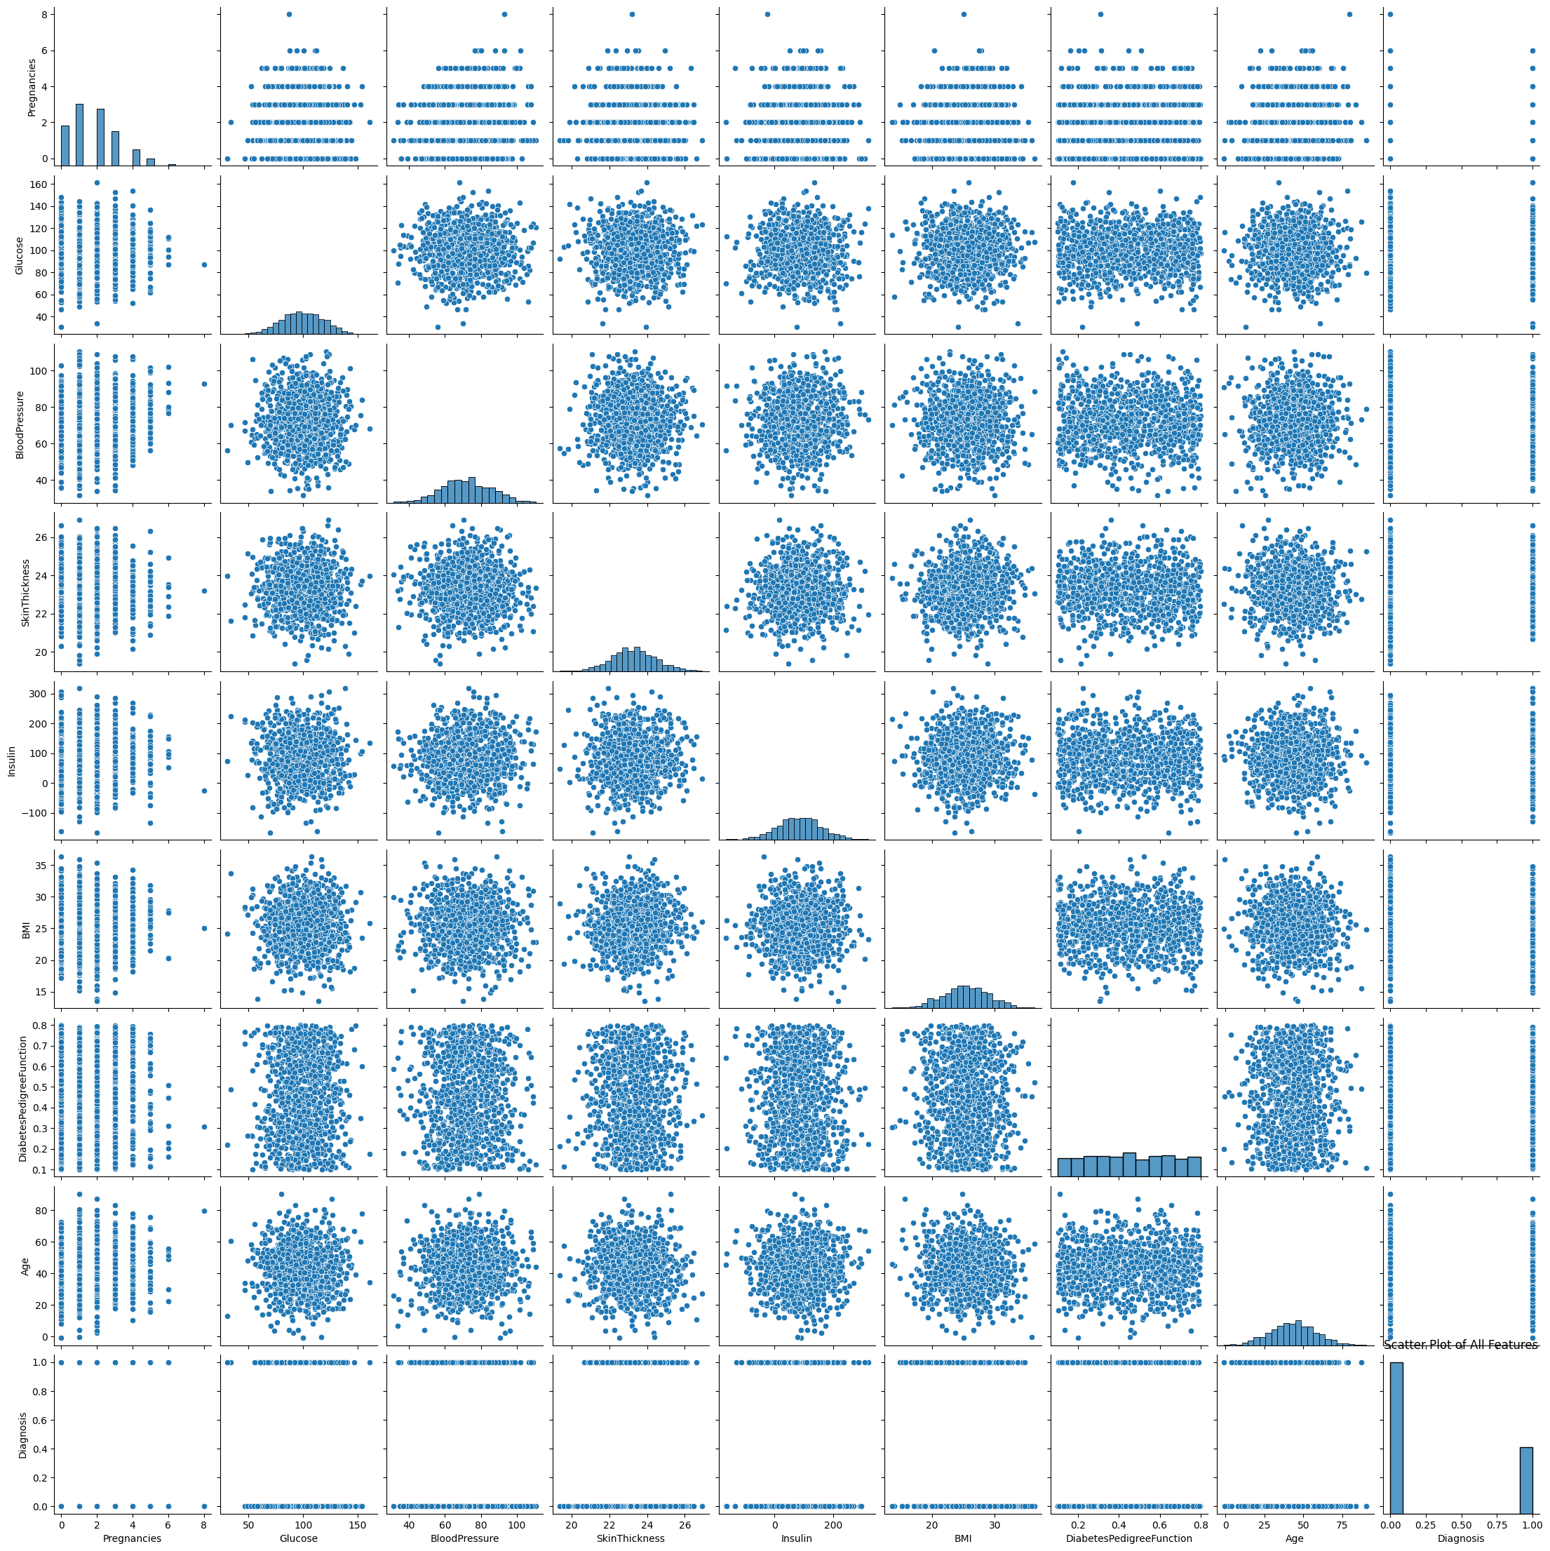
Scatter plot of all features
The scatter plot matrix displays the pairwise relationships between all numerical features, helping to identify correlations or trends between features

Slide 11
What features do you select? Why?

Slide 12
1.Glucose: The selection was made because blood glucose levels are a major sign of diabetes and are therefore highly useful in diabetes analysis and prediction. Glucose appears to fluctuate considerably throughout the dataset in the plot, and it may be correlated with other variables like age or BMI.
2. Age: Selection criteria: Age is a significant demographic component, and diabetes may be more common in older people. Age can be used to investigate correlations between BMI or glucose levels in various age groups in the scatter plot matrix.
3. Body Mass Index (BMI): Selection rationale: Another important factor is BMI, since a high BMI is frequently linked to an increased risk of diabetes. This variable also has a variety of values, as the scatter plot demonstrates, which may be a sign of a link with insulin and glucose levels.

Slide 13
Why These Features ?
Medical Significance: It is established that the three characteristics that were chosen—BMI, age, and glucose—have an impact on the chance of developing diabetes.
Predictive Power: These variables exhibit variability based on pair plots, and they may have predictive power in the process of developing a machine learning model.
Potential Relationships: It is helpful to conduct additional research as the scatter plot matrix indicates that there may be connections between glucose and both age and body mass index.
Pregnancies, Glucose, skin thickness,BMI,Insulin,Blood pressure ,Diabetes pedigree function, Age ,Diagnosis are features selected for the scatter plot.
From a medical and statistical standpoint, these characteristics are essential to comprehending diabetes. The scatter plot facilitates the identification of patterns, relationships, and trends associated with diabetes by incorporating a broad variety of physiological (e.g., glucose, BMI), demographic (e.g., age, pregnancies), and genetic (e.g., diabetes pedigree function) variables.

Slide 14
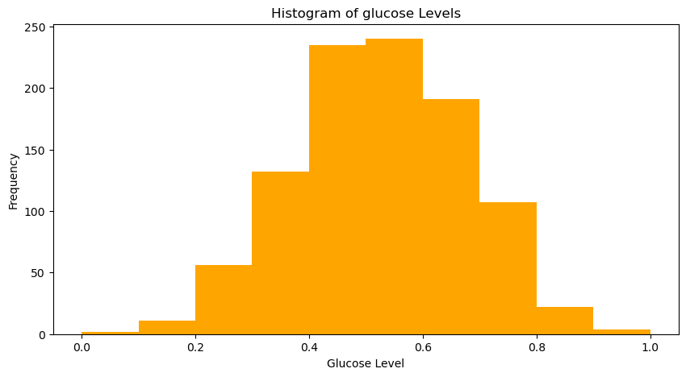
HISTOGRAM OF GLUCOSE
The histogram shows, the majority of the dataset's glucose levels are clustered between 0.3 and 0.7, with 0.4 and 0.6 having the largest frequency. A normal-like distribution of glucose levels is indicated by the distribution's moderate balance and lack of excessive skewness. In this sample, extreme low and high glucose levels are uncommon.

Slide 15
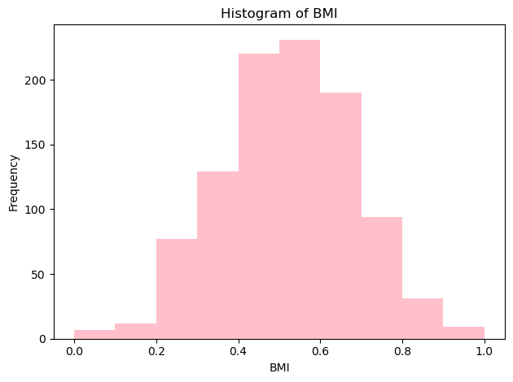
HISTOGRAM OF BMI:-
Based on the histogram, the majority of BMI readings fall within the range of 0.3 to 0.7, with a peak observed at 0.5. With few extreme values at the low and high ends, the distribution is approximately normal.

Slide 16
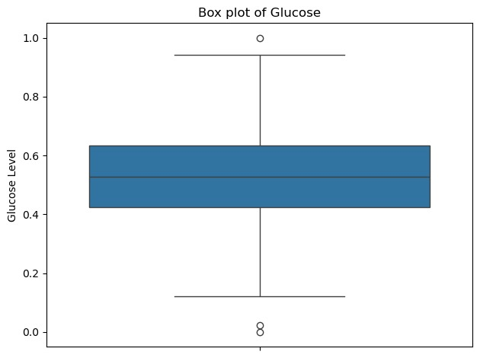
BOX PLOT OF GLUCOSE
According to the box plot, the majority of glucose readings fall between 0.4 and 0.6, with 0.5 serving as the median. The distribution is pretty balanced overall, with the exception of a little outlier close to 1.0.

Slide 17
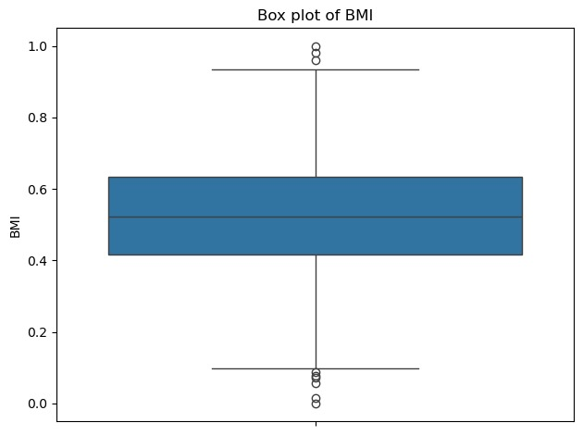
BOX PLOT OF BMI
The box plot shows that the BMI values are concentrated between 0.4 and 0.7, with a median around 0.55. There are a few outliers both below 0.2 and above 0.85. The interquartile range (IQR) covers most of the data, and the distribution seems symmetric. The presence of outliers indicates some individuals with unusually low or high BMI values.

Slide 18
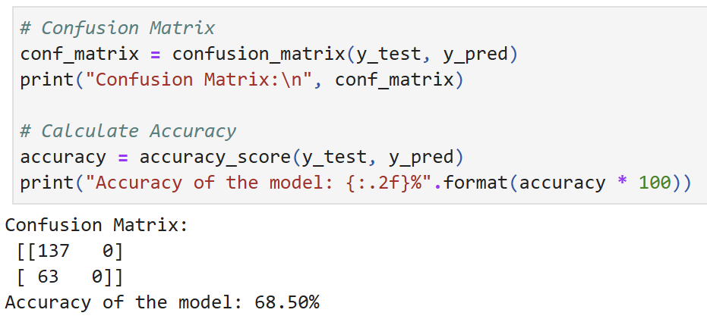
Step 3 - Regression
Since our issue is to predict a binary result (whether or not someone has diabetes, denoted as 0 or 1 in the Diagnosis column), logistic regression is being used instead of linear regression.
For a binary classification problem such as this one, linear regression is not appropriate since it predicts continuous numerical values. In contrast, logistic regression is specifically meant for jobs involving classification. It makes a prediction about the likelihood of an event (in this case, the likelihood of acquiring diabetes) and then divides the outcome into two groups (0 and 1).
>The model exhibits severe bias since it solely predicts the negative class in every situation.
->The model performs poorly because it is completely unable to identify affirmative cases, even with an accuracy of 68.50%.
->With 137 negative and 63 positive cases in the test set, there's probably a class imbalance problem.
->The model misses all 63 positive examples and obtains 0% recall for the positive class.
->To effectively handle both classes, this model needs major modifications and is not fit for deployment.

Slide 19
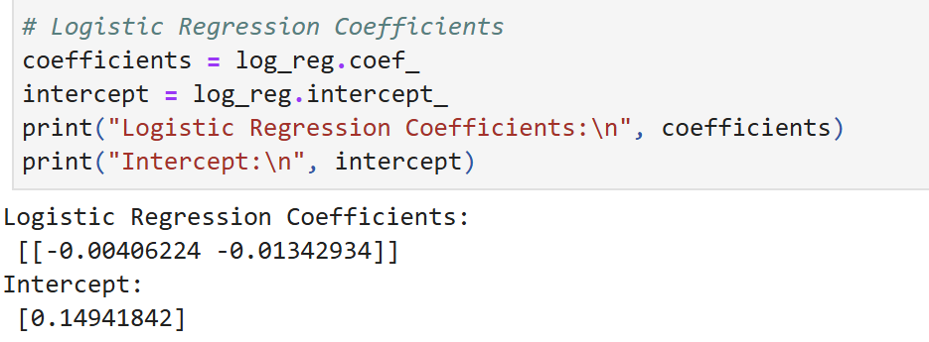
# Confusion Matrix
conf_matrix = confusion_matrix(y_test, y_pred)
print("Confusion Matrix:\n", conf_matrix)
# Calculate Accuracy
accuracy = accuracy_score(y_test, y_pred)
print("Accuracy of the model: {:.2f}%".format(accuracy * 100))
Coefficients (y = aX + b)
a = [-0.00406224, -0.01342934]
b = 0.14941842
Small negative coefficients in the logistic regression model (-0.00406224 and -0.01342934) for both features indicate weak inverse correlations with the likelihood of the positive class. Because its absolute coefficient is bigger, the second feature has a marginally stronger influence.
When all characteristics are zero, the positive intercept (0.14941842) indicates a little bias towards the positive class. The minimal size of these coefficients, however, suggests that the characteristics may not have much predictive potential or that the model may be underfit, which could account for the earlier observed poor performance.

Slide 20
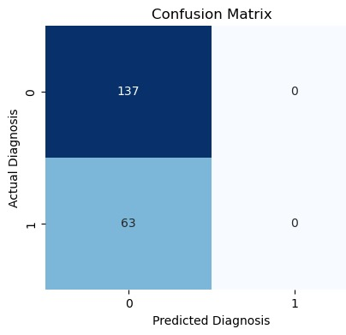
# Plot the Confusion Matrix plt.figure(figsize=(5,4)) sns.heatmap(conf_matrix, annot=True, fmt="d", cmap="Blues", cbar=False) plt.title('Confusion Matrix') plt.ylabel('Actual Diagnosis') plt.xlabel('Predicted Diagnosis') plt.show()
INTERPRETATION:-
This representation of the confusion matrix gives a clear sense of the model's performance:
Model Bias: There is a strong bias towards the negative class as the model only predicts one class (class 0) in every occurrence.
True Negatives: The top-left cell contains 137 true negatives, or negative cases that were accurately predicted. 3. False Negatives: The model misclassified 63 positive cases as negative, as evidenced by the 63 false negatives displayed in the bottom-left cell. 4.No Positive Predictions: The model did not predict any positive cases, as seen by the zeros in the right-side cells (0, 1) and (1, 1).
The model performs poorly, as this picture demonstrates, especially in its total inability to find any positive situations. With its constant output of the negative class, the model is effectively acting as a constant predictor, independent of the input. This implies that there are significant problems with the model itself, the training procedure, or perhaps the caliber or distribution of the training data. This model needs to be significantly improved before it can be used in any real-world situation.

Slide 21
Step 4: KNN & Naïve Bayes ❖ Major Discussion K Nearest Neighbor Naïve Bayes
CODE
# Plottingplt.figure(figsize=(12, 5))
# KNN plot
plt.subplot(1, 2, 1)
plt.scatter(X_test['Glucose'], X_test['BMI'], c=knn_pred, cmap='coolwarm', edgecolor='k', s=100)
plt.title('KNN Predictions’)
plt.xlabel('Glucose’)
plt.ylabel('BMI’)
# Naive Bayes plot
plt.subplot(1, 2, 2)
plt.scatter(X_test['Glucose'], X_test['BMI'], c=nb_pred, cmap='coolwarm', edgecolor='k', s=100)
plt.title('Naive Bayes Predictions’)
plt.xlabel('Glucose’)
plt.ylabel('BMI’)
plt.tight_layout()
plt.show()

Slide 22
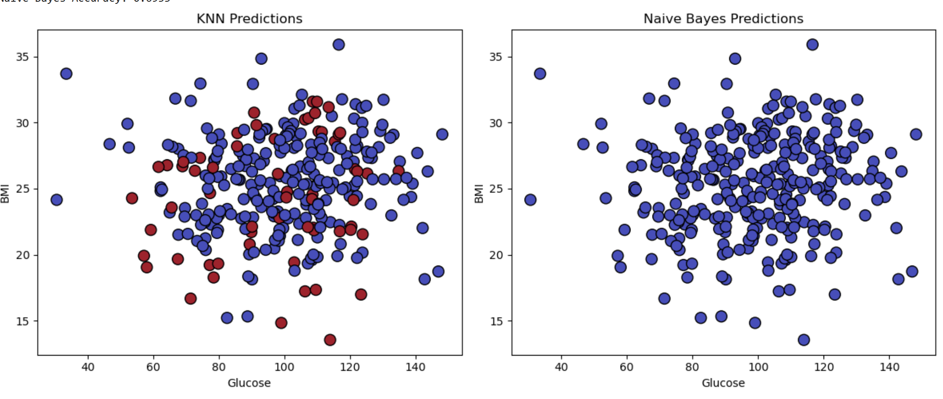
GRAPHS OF KNN AND NAÏVE BAYES

Slide 23
Report the accuracies:-
KNN achieved 62.00% accuracy, or 62 out of 100 predictions.
69.33% of the predictions made by Naive Bayes were accurate out of 100.

Slide 24

What model works better for this data?
For this dataset, Naive Bayes performs better because of greater accuracy of 69.33% as opposed to 62.00% for KNN .
Though the decision boundary is simpler, it is more efficient.
Improved generality in spite of cautious forecasts.
However, crucial factors should take into account:The accuracy of both is moderate (less than 70%).
Results could be enhanced by using different algorithms or feature engineering.
Whether reducing false positives or false negatives is more crucial for the particular application may determine the final model selection.
CONCLUSION:-
Based on accuracy, Naive Bayes is the superior option in this case; however, total model performance might be enhanced.

Slide 25
Step 5: SVM
❖ Major Discussion
• SVM • Kernels

Slide 26
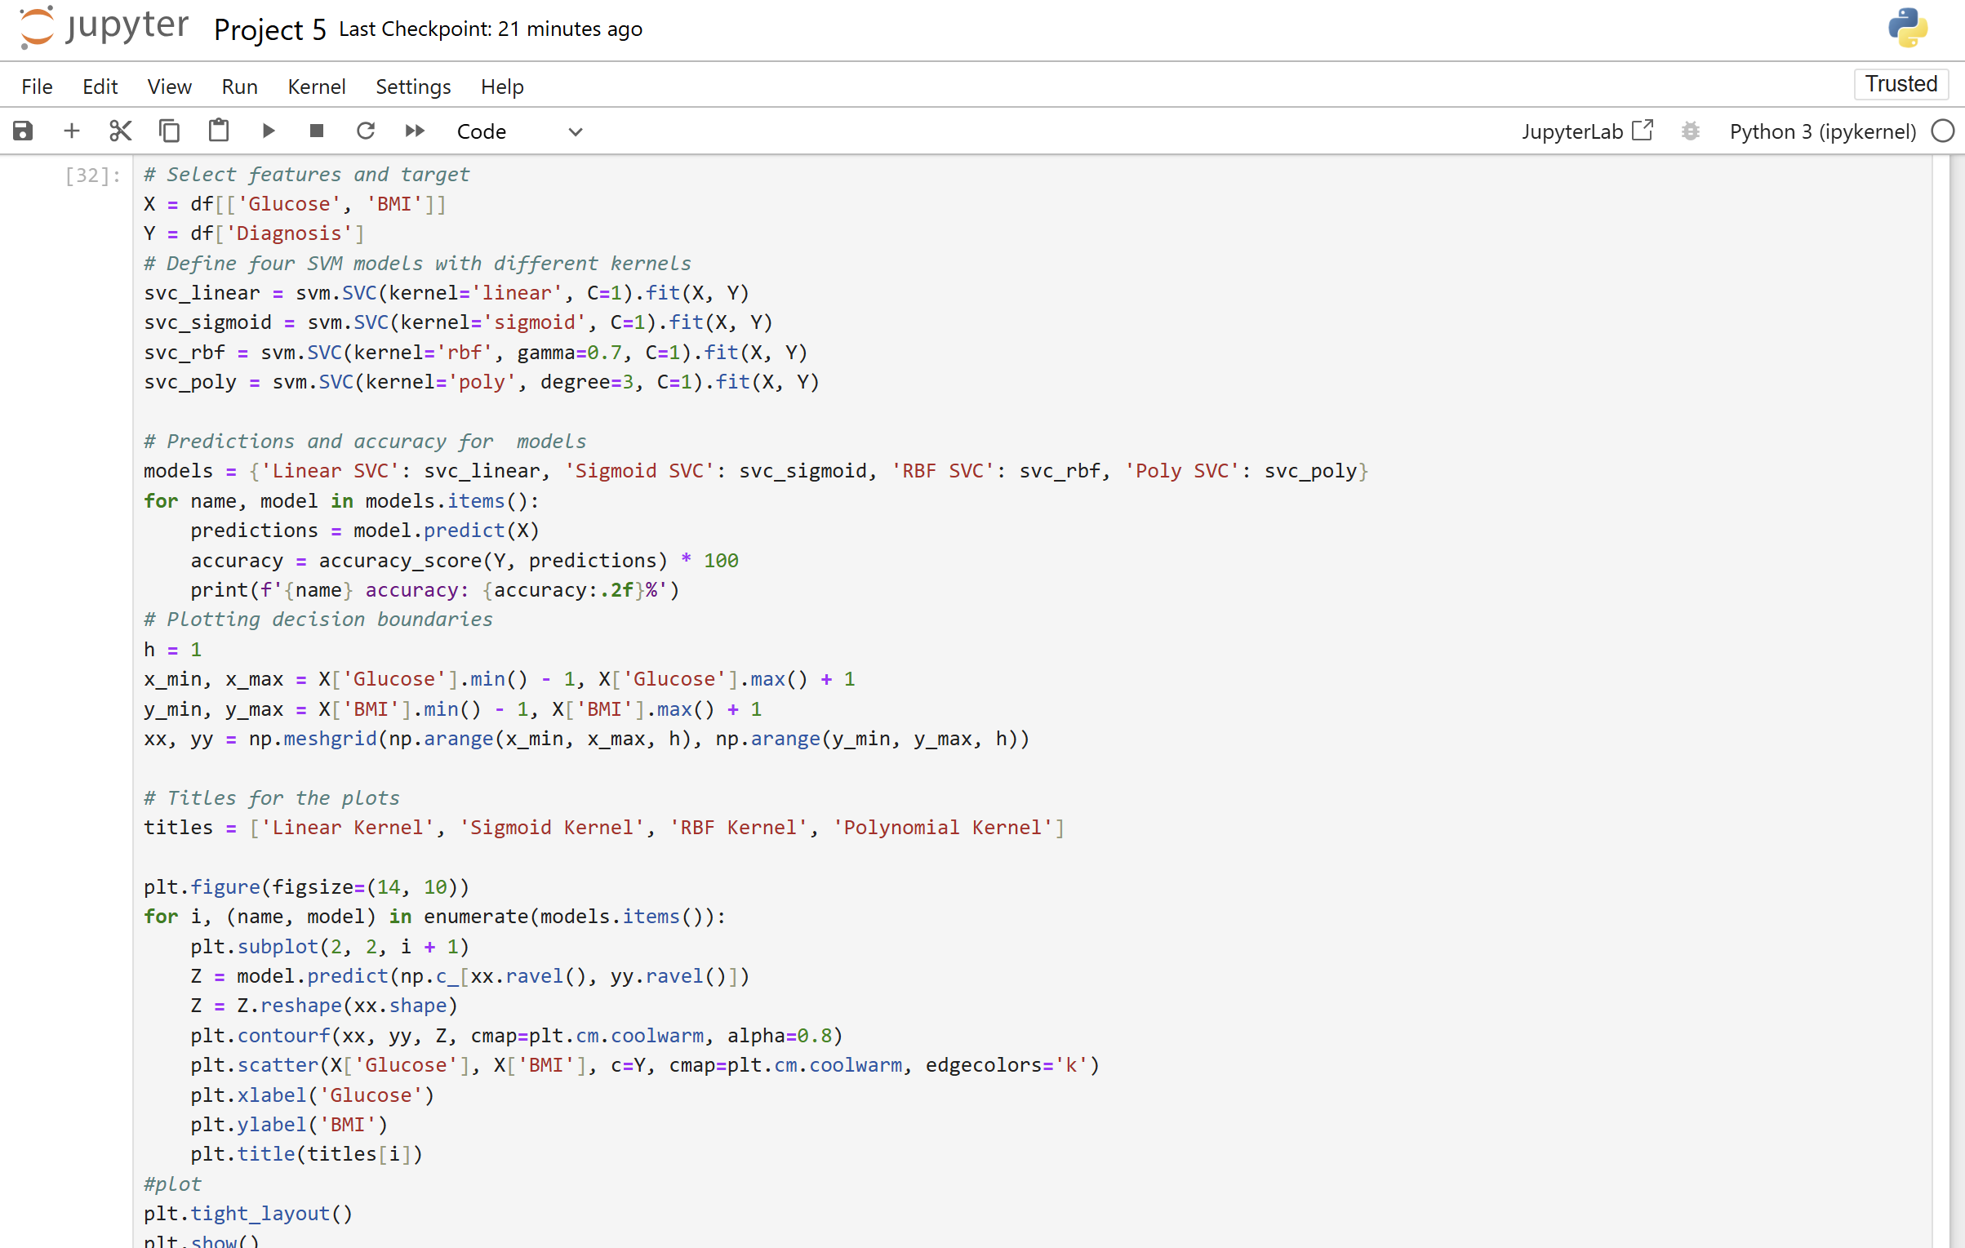
Codes

Slide 27
GRAPHS

Slide 28
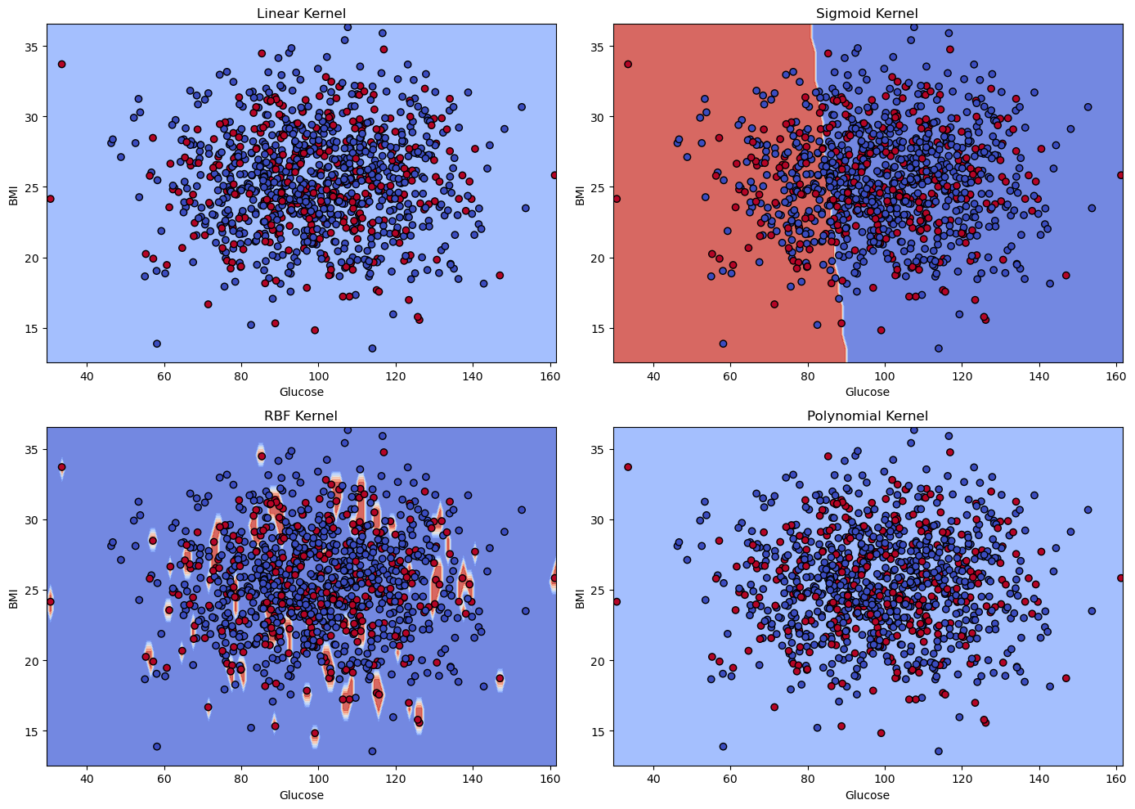

Slide 29
ACCURACIES
Linear SVC accuracy: 69.40%
Sigmoid SVC accuracy: 59.70%
RBF SVC accuracy: 80.90%
Poly SVC accuracy: 69.40%
The RBF SVC model has the highest accuracy (80.90%).This shows that the RBF (Radial Basis Function) kernel may be a better fit for this dataset than the linear, sigmoid, and polynomial kernels.

Slide 30

INTERPRETATION OF RESULTS
The RBF kernel achieves the maximum accuracy (80.9%) and has the most accurate classification boundary. This suggests that the data has a complex structure that necessitates a flexible, nonlinear decision boundary.
The Sigmoid kernel aims to generate non-linearity but performs poorly owing to simplicity.Linear and polynomial kernels struggle to represent the classes' overlapping nature, resulting in lesser accuracy.
In conclusion, for this dataset, the RBF kernel is the most effective choice among the four since it can describe non-linear patterns and adapt to the underlying data structure.

Slide 31
Step 6: ❖ Major Discussion
A Random Forest Classifier is an ensemble machine learning technique that creates several decision trees from random selections of data and features. It employs **bagging** (Bootstrap Aggregation) to provide variety to the trees and then combines their predictions using majority vote (for classification) or averaging (for regression). It is resilient, prevents overfitting, and works well with huge datasets.
Key hyperparameters include the number of trees ('n_estimators'), the maximum tree depth ('max_depth'), and the number of features evaluated. Random Forest is widely applied in fields such as fraud detection, medical diagnosis, and customer segmentation.
Random Forest

Slide 32
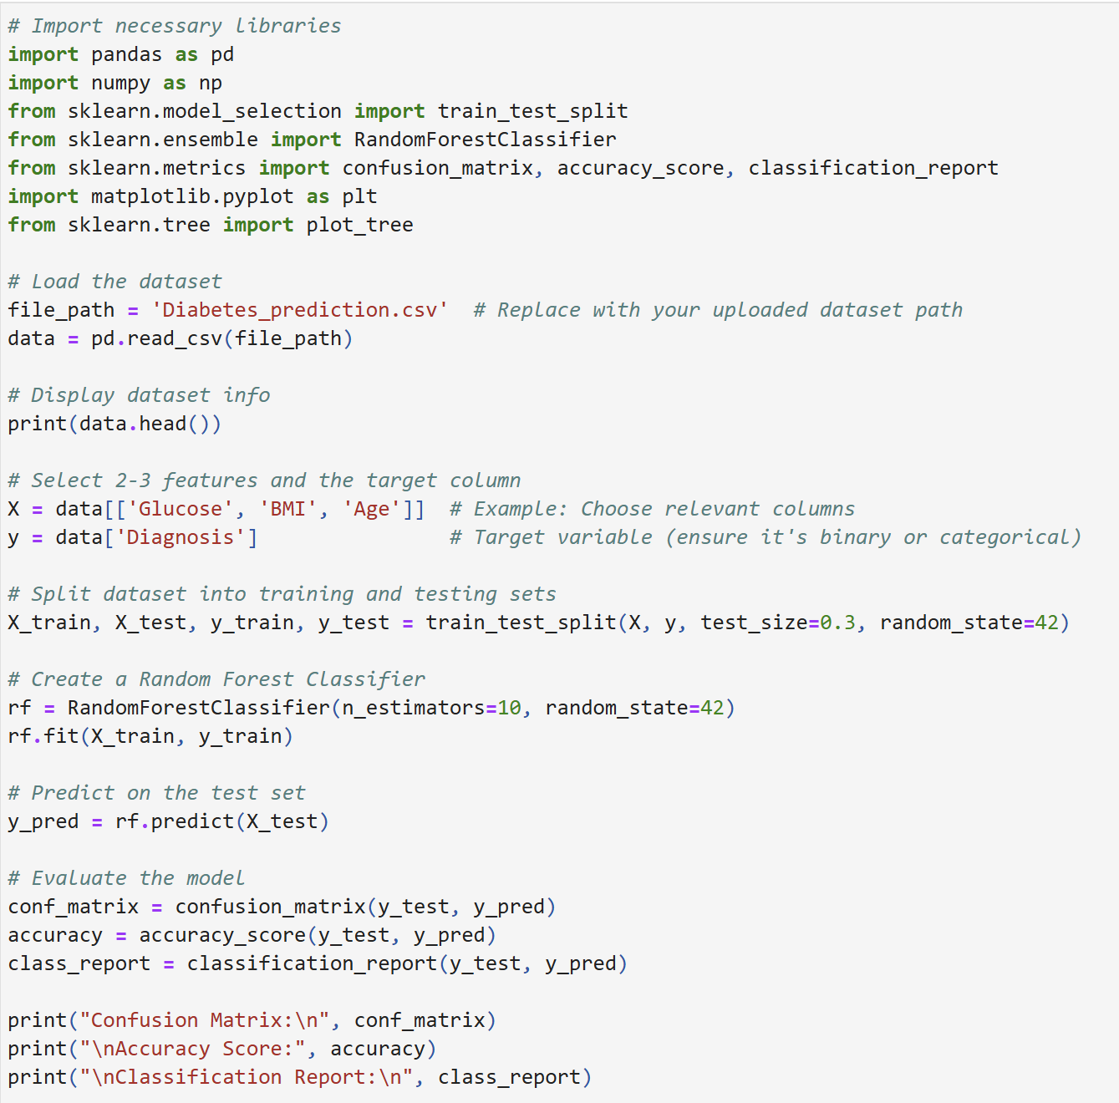
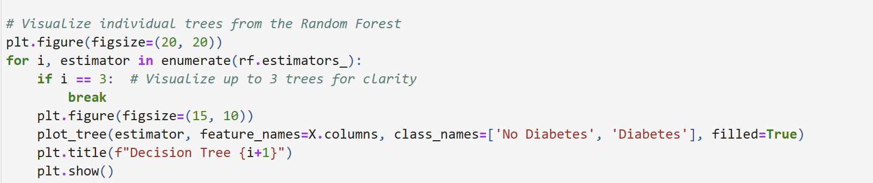
CODES:-

Slide 33
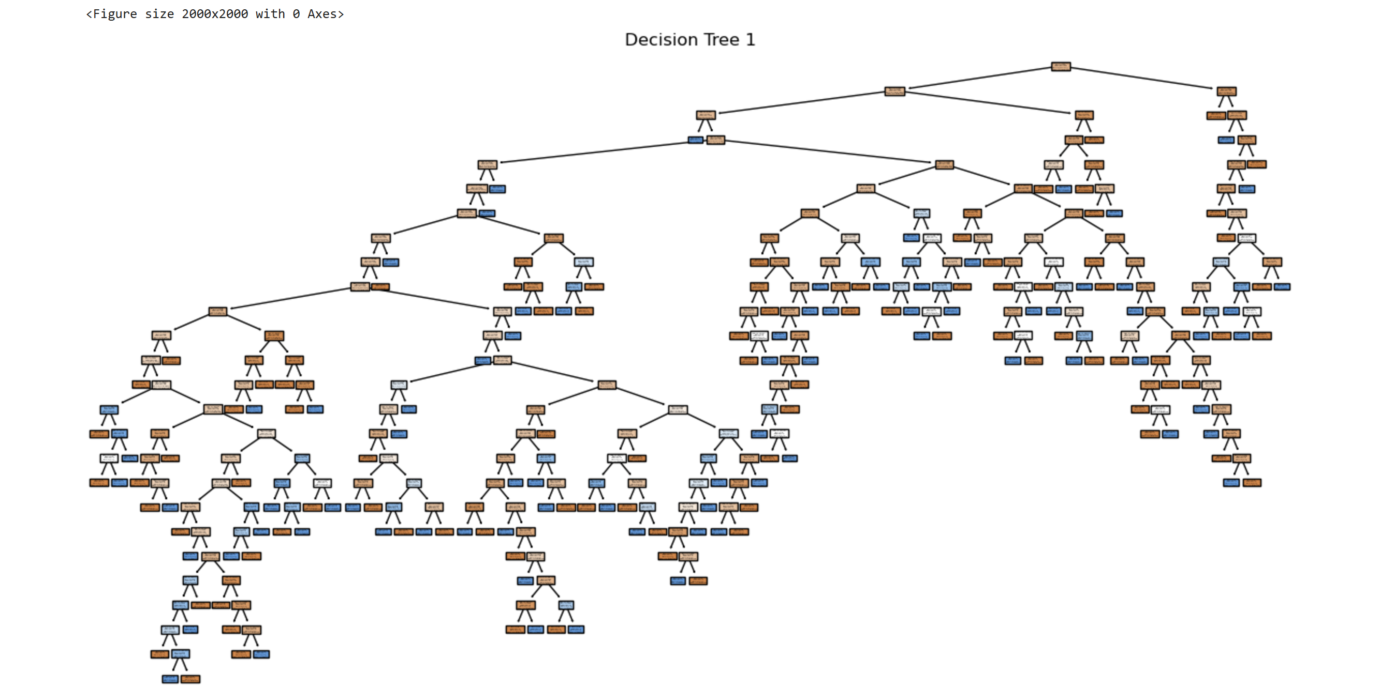
GRAPHS

Slide 34
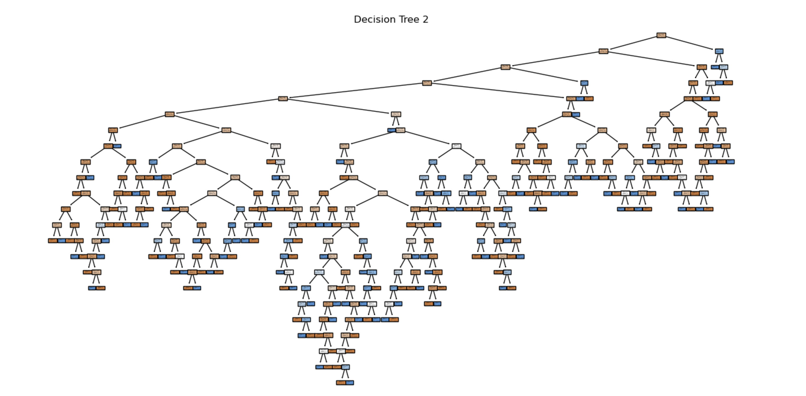

Slide 35
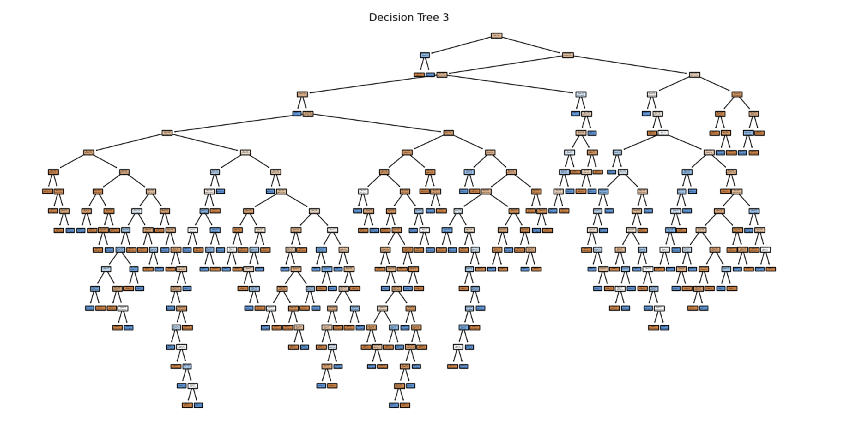

Slide 36
INTERPRETATION:-
Accuracy: 0.62 - 62% of predictions were correct overall.
Classification Report:
Class 0 (No Diabetes):
Precision: 0.68
Recall: 0.85
F1-Score: 0.76
Class 1 (Diabetes):
Precision: 0.23
Recall: 0.10
F1-Score: 0.14
Weighted Avg F1-Score: 0.57

Slide 37
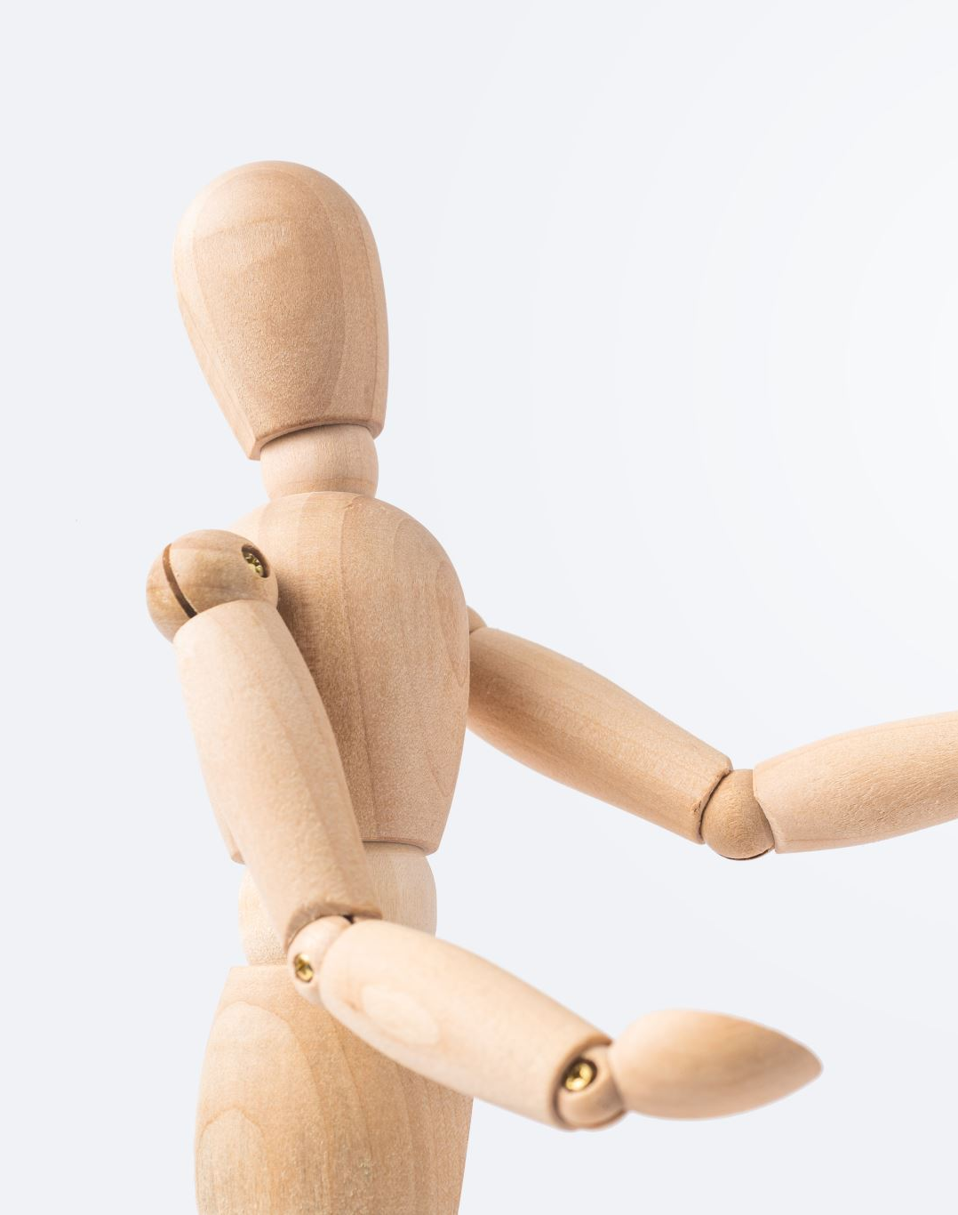
Results based on accuracy
Model Performance: The model performs well in predicting non-diabetic cases (class 0), with high recall and precision. However, it performs badly in diabetes patients (class 1), most likely because to unbalanced data or inadequate feature representation.
While the accuracy is moderate (62%), it is exaggerated by the class imbalance, since most forecasts favor the majority class (class 0).

Slide 38
CONCLUSION:-
The goal of this study was to create a prediction model for early detection of gestational diabetes mellitus utilizing a variety of machine learning approaches.
The analysis showed that:
Feature Selection and Visualization: Critical predictors such as glucose and BMI were identified, providing information about their influence on diabetes risk.
Among examined models, Naïve Bayes performed the best with a reasonable accuracy of 69.33%. However, there is opportunity for improvement with advanced approaches.
The RBF kernel of the SVM model had the best accuracy of 80.9%, demonstrating that it is well-suited to capture complicated patterns in the dataset.
Challenges: Models such as logistic regression and random forests had limitations due to class imbalance and potential underfitting.

Slide 39
Addressing data imbalances and developing new features can improve model performance.
Exploring sophisticated ensemble approaches or deep learning may yield more robust results.
This study emphasizes the relevance of accurate models in improving clinical decision-making and patient care by highlighting machine learning's potential for predicting health outcomes.
Future recommendations

Slide 40
REFERENCES:-
Amazon Web Services. (n.d.). What is logistic regression? Retrieved December 1, 2024, from https://aws.amazon.com/what-is/logistic-regression/
mrsimple07. (n.d.). Diabetes prediction dataset. Kaggle. Retrieved December 1, 2024, from https://www.kaggle.com/datasets/mrsimple07/diabetes-prediction
Data Science Institute. (n.d.). Binary logistic regression: An introduction. Retrieved December 1, 2024, from https://www.datascienceinstitute.net/blog/binary-logistic-regression-an-introduction

Slide 41
CONTRIBUTION:-
Rathnakar Rajanala- Data collection, Data description ,project 1.
Sai kumar chary sripathi – project 2 to 3 , coding.
Neha sri Tella – project 4 and 5 ,coding .
Roshini amulla – project 6 , data collection and coding.
Lakshmi Anusha – project 6 , logistic regression

